Slide 1
Capstone Project - 2
Cardiovascular Risk Prediction Team Members Amrutha B S Mahima Shree Purnima Rai Pooja Rana Tanmay Bohra Vikram Pratap

Slide 2
Index
Problem Statement
Data Description
Project Workflow
EDA – Feature Analysis
Data Cleaning
Feature Engineering
EDA on Features
Handling Imbalance Data
Evaluation Metric
Data Splitting & Standardizing
Model Training, Testing & Hyper-Parameter Tuning
Model Performance Comparison & Conclusion
Scope of Improvement

Slide 3
Problem Statement
Heart disease is the leading cause of morbidity and mortality worldwide, killing more people each year than any other cause.
In this project, we shall be giving you a walk through on the development of a screening tool for predicting whether a patient has a 10-year risk of developing coronary heart disease (CHD) using different Machine Learning techniques.
The given dataset provides the patients’ information. It includes over 3,390 records and 17 attributes. Each attribute is a potential risk factor. There are both demographic, behavioural, and medical risk factors given for the analysis.

Slide 4
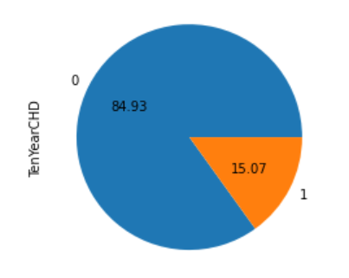
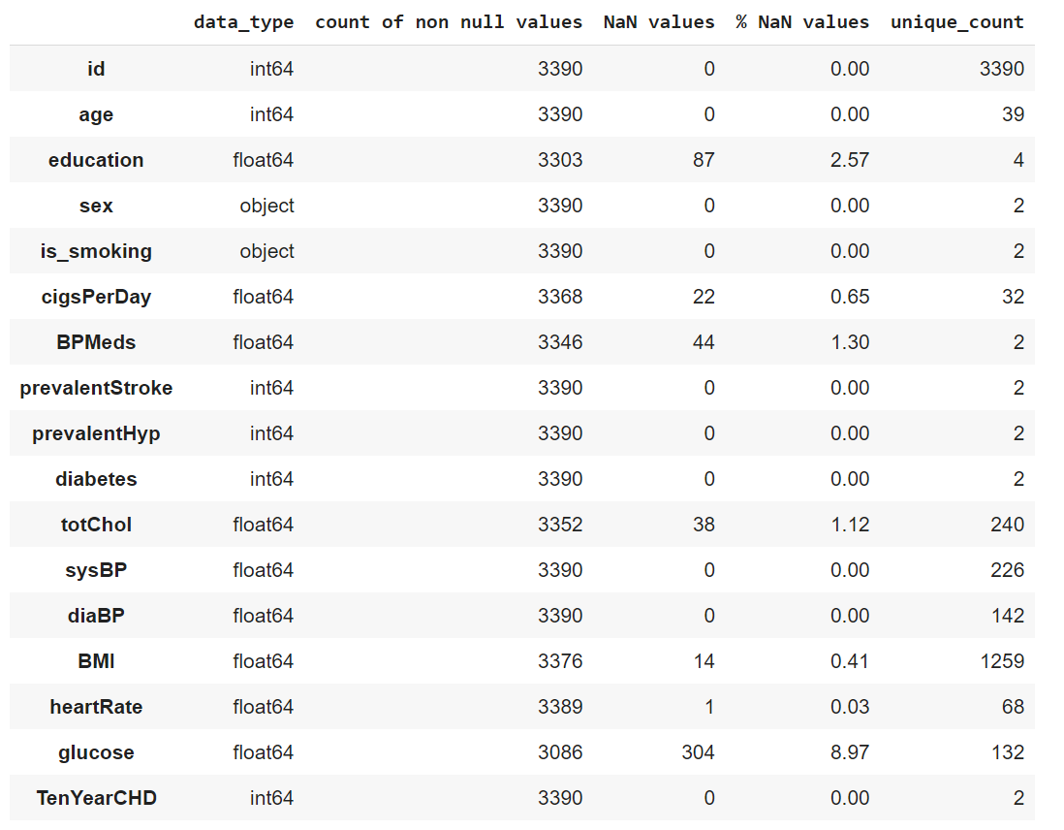
Data Description
Data Description
85% Majority Set – No CHD Risk
15% Minority Set – CHD Risk

Slide 5
Project Workflow
Data Wrangling
Checking for Duplicates – None found
Checking for garbage data – None found
EDA – Feature Analysis
Heat Map
Data Cleaning
Handling NaN values – 510 NaN values which is 0.01% of the entire dataset
Outlier Treatment
Feature Engineering
Binary Encoding / One-Hot Encoding
Deriving of a new feature i.e., avgBP (replacing diaBP & sysBP)
EDA on Features
Handling Imbalance Data
Model Training, Testing & Hyper-Parameter Tuning
Performance Comparison

Slide 6
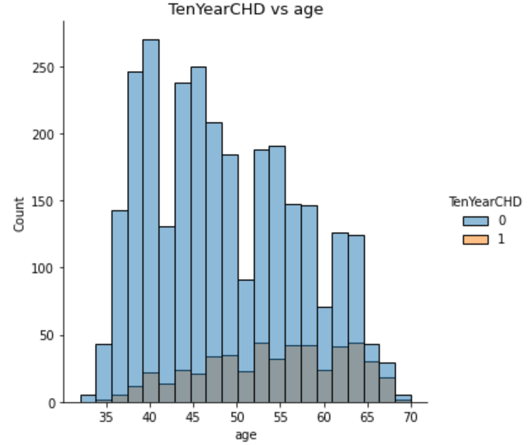
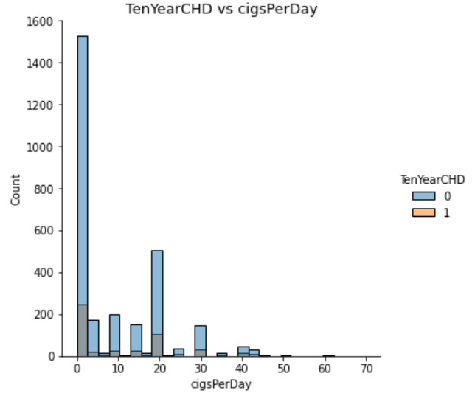
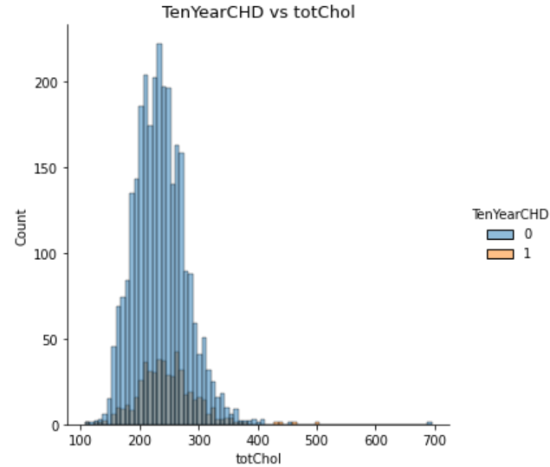
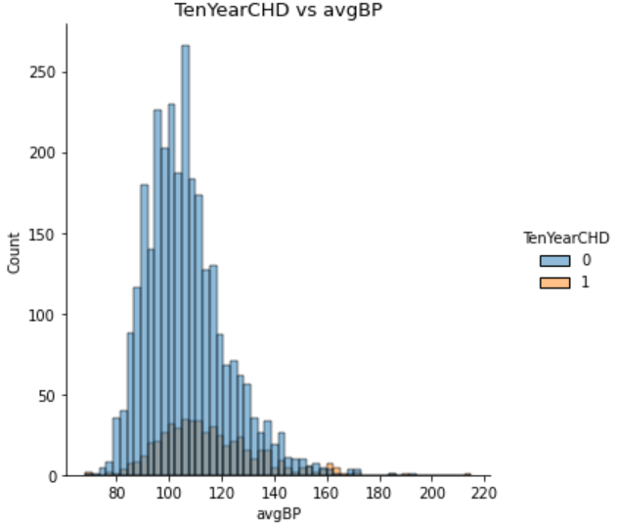
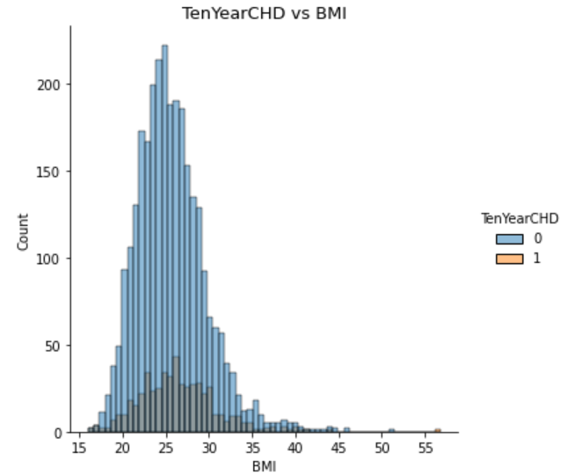
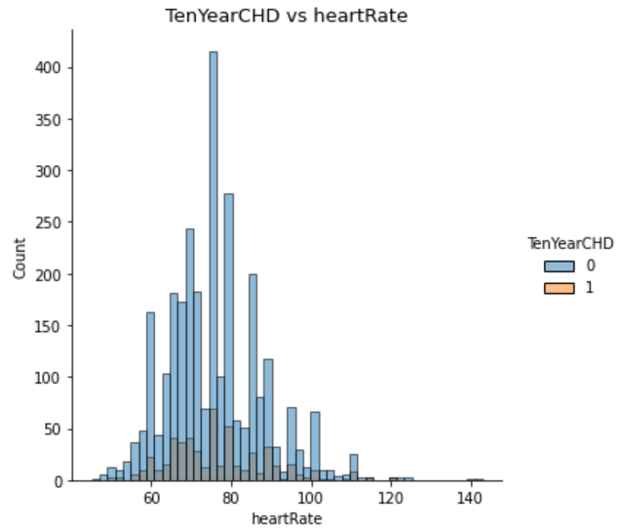
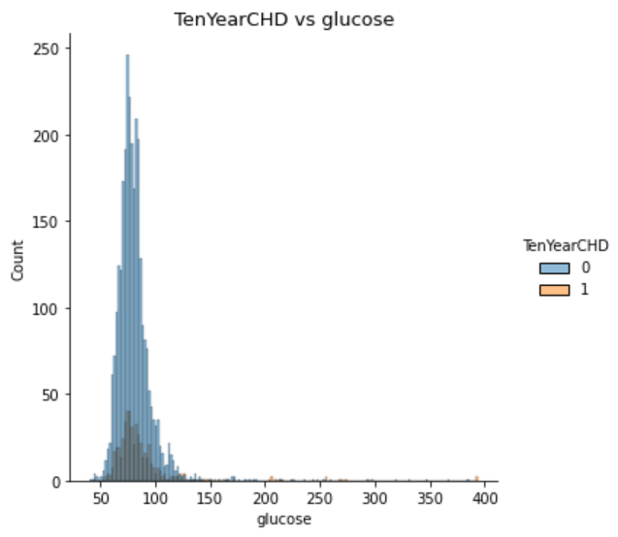
EDA – Feature Analysis on Continuous Features

Slide 7
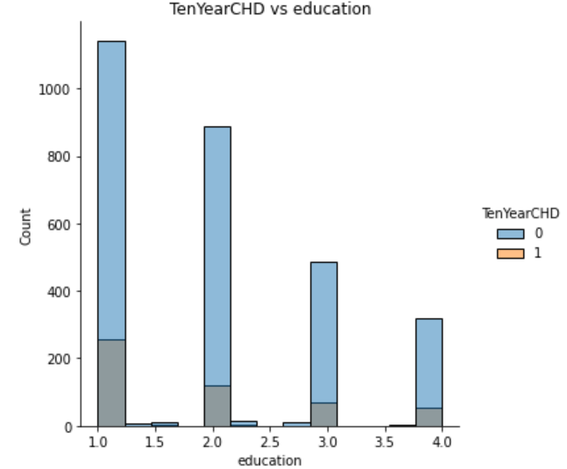
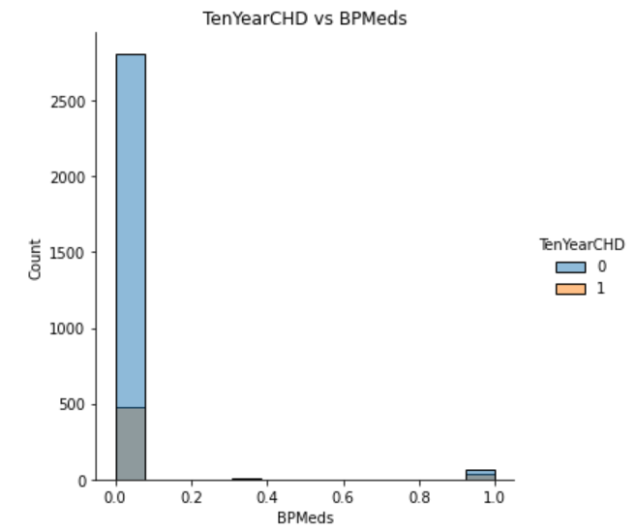
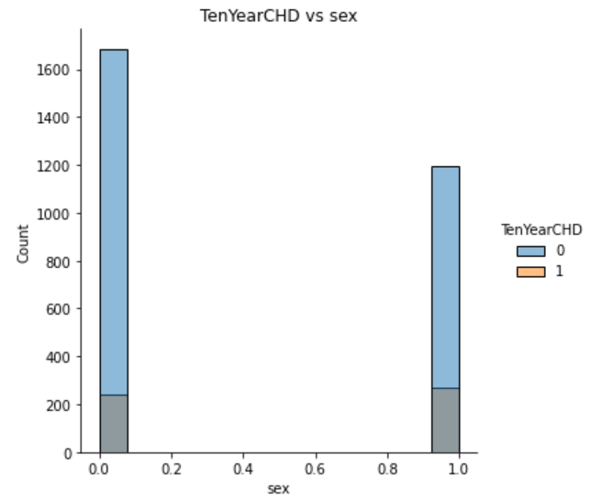
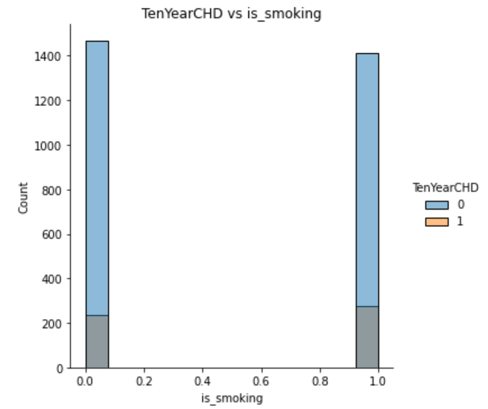
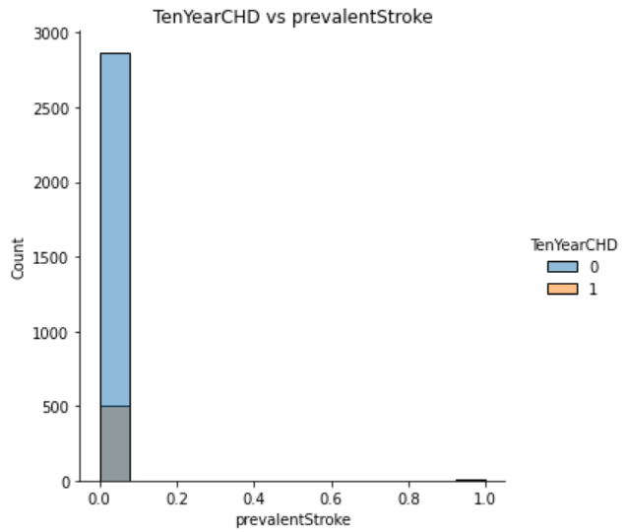
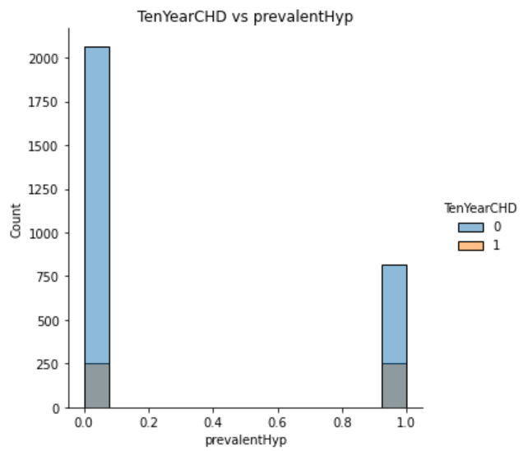
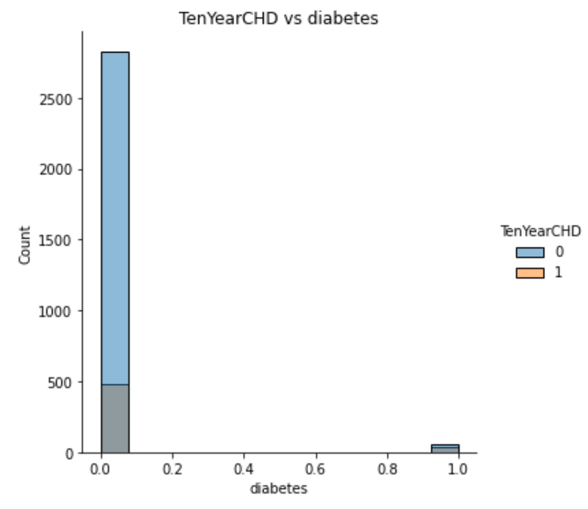
EDA – Feature Analysis on Discrete Features

Slide 8
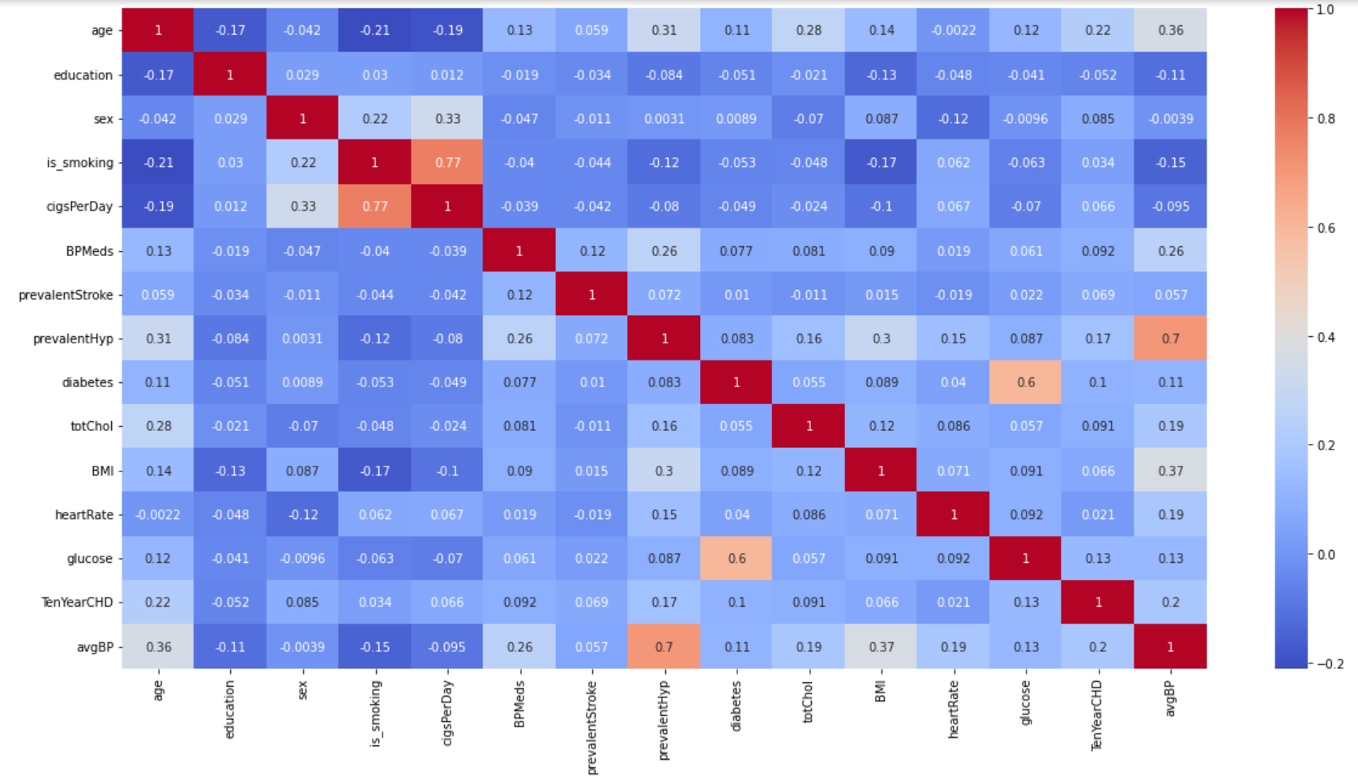
Heat Map
As we can see from the correlation graph above- the features of low variance- i.e, BPMeds, prevalentstroke, diabetes has no direct or good linear relationship with the target variable (TenYearCHD).

Slide 9
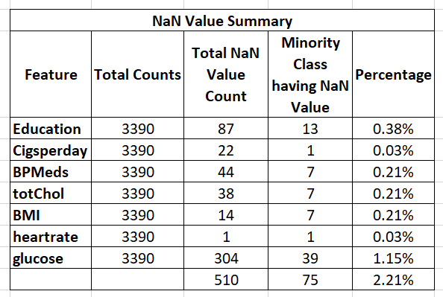
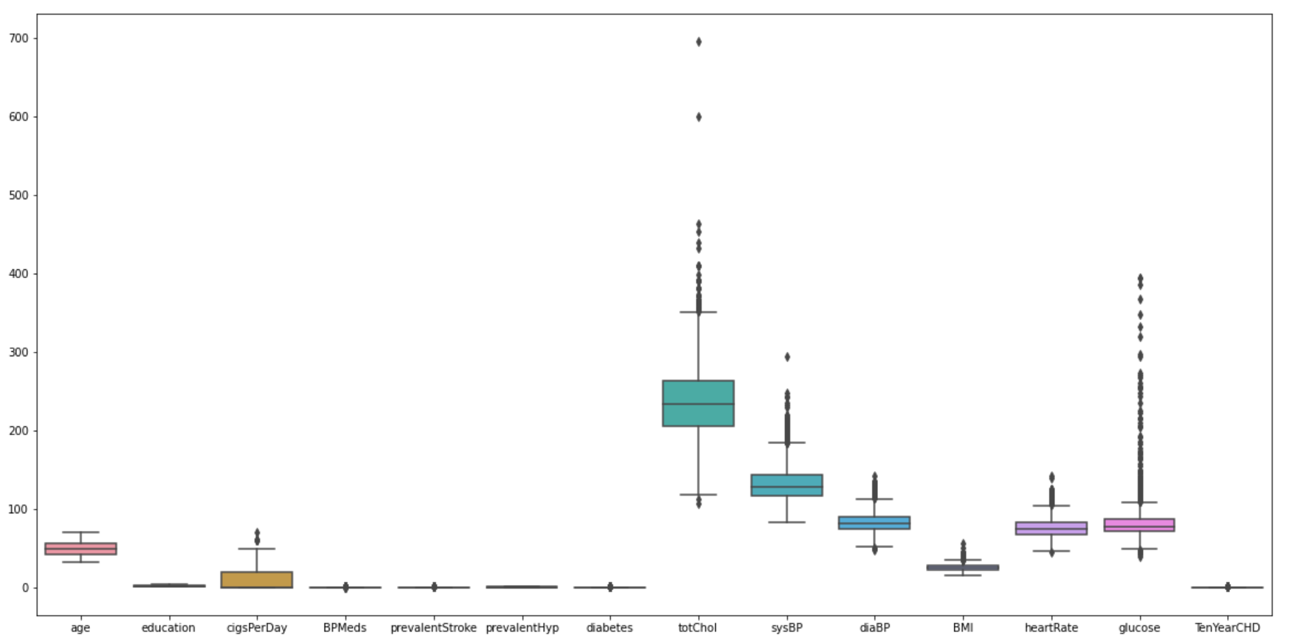
Data Cleaning
Handling NaN Values
KNN Imputer – For continuous
Simple Imputer – For categorical
Outlier Treatment
totChol has values > 600
Replacing that with 500

Slide 10
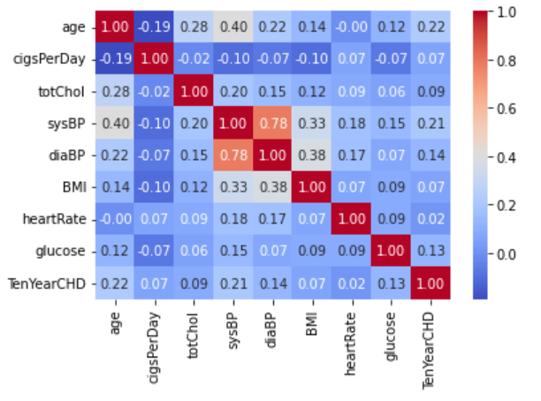
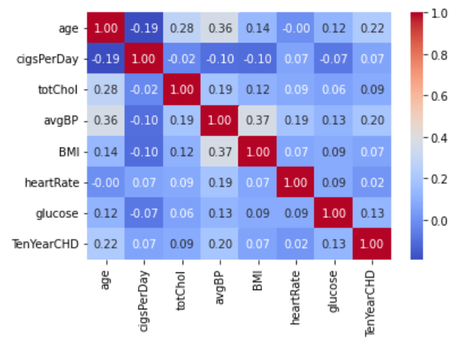
Feature Engineering
Binary Encoding / One-Hot Encoding
sex & is_smoking has (Male/Female) and (Yes/No) data respectively.
Since only two features are to be treated, we simply did binary encoding to represent (Male = 1, Female = 0) & (Yes = 1 & No = 0)
New Feature – avgBP
We have diaBP & sysBP in our dataset, which represents diastolic and systolic BP.
For a healthy person BP measure is 120/80.
Both these are co-related with each other (78%).
avgBP = (sysBP+diaBP)/2

Slide 11
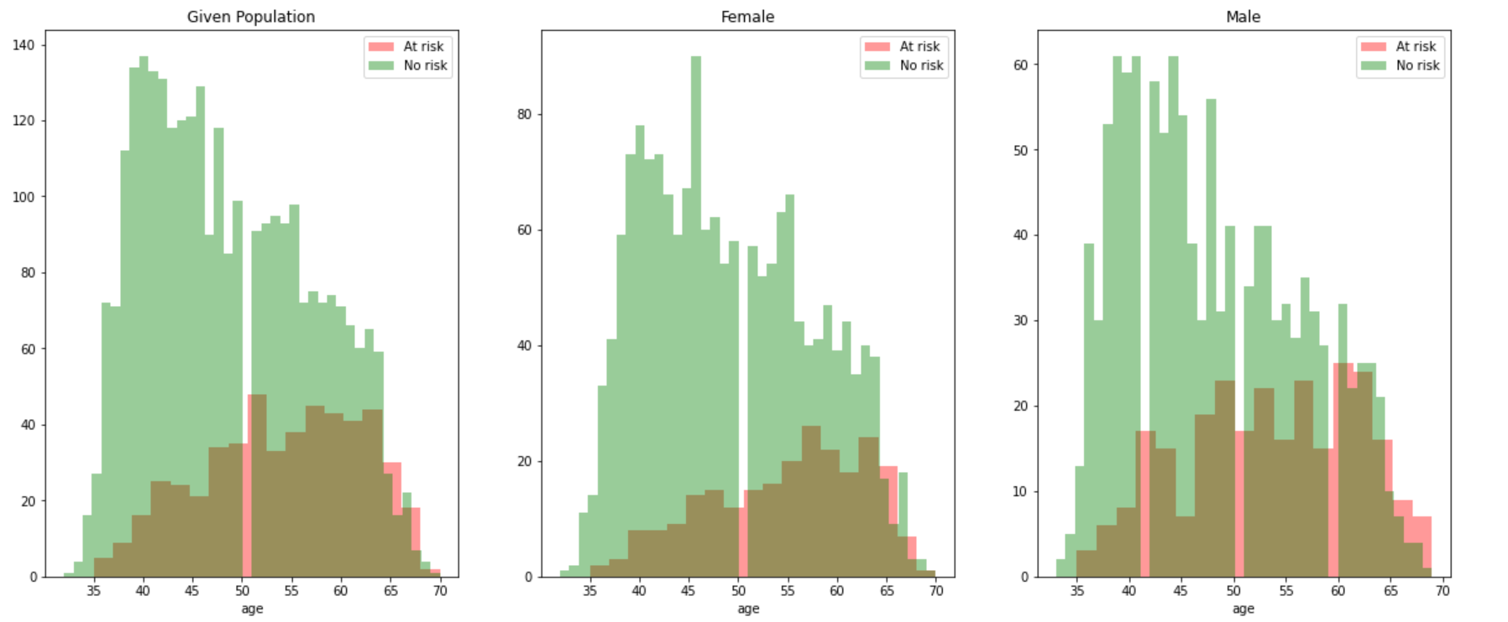
EDA on Features – Age & Sex
Both Women and Men lying in Age group of 50-52 have high risk of heart disease.
Men lying in age group 40-42 are at risk.
Men having age more than 65 are also at risk.

Slide 12
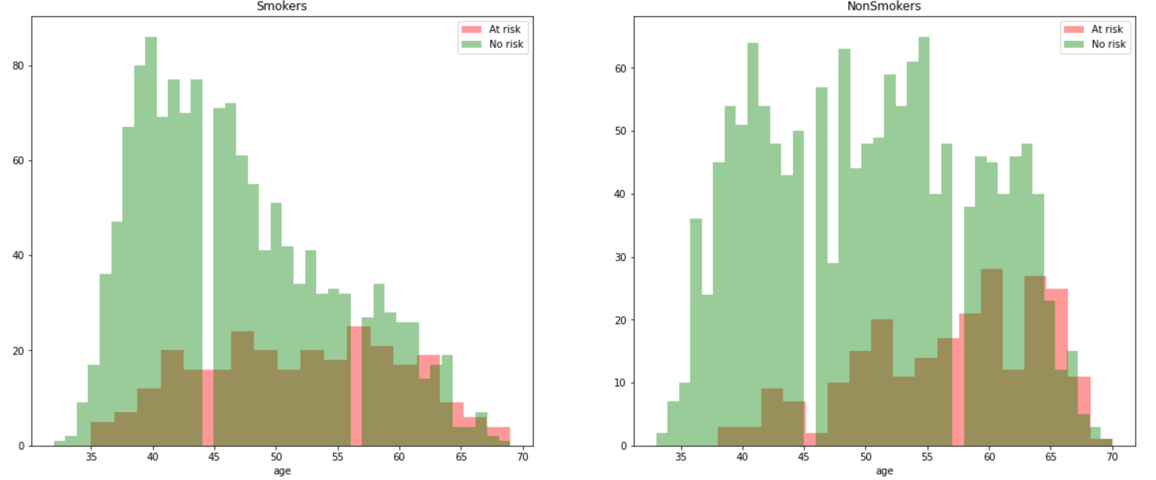
EDA on Features – Age & Smoking
Risk is High in age group of (42 to 45),(56 to 58) and age above 62 despite they are smoking or not.

Slide 13
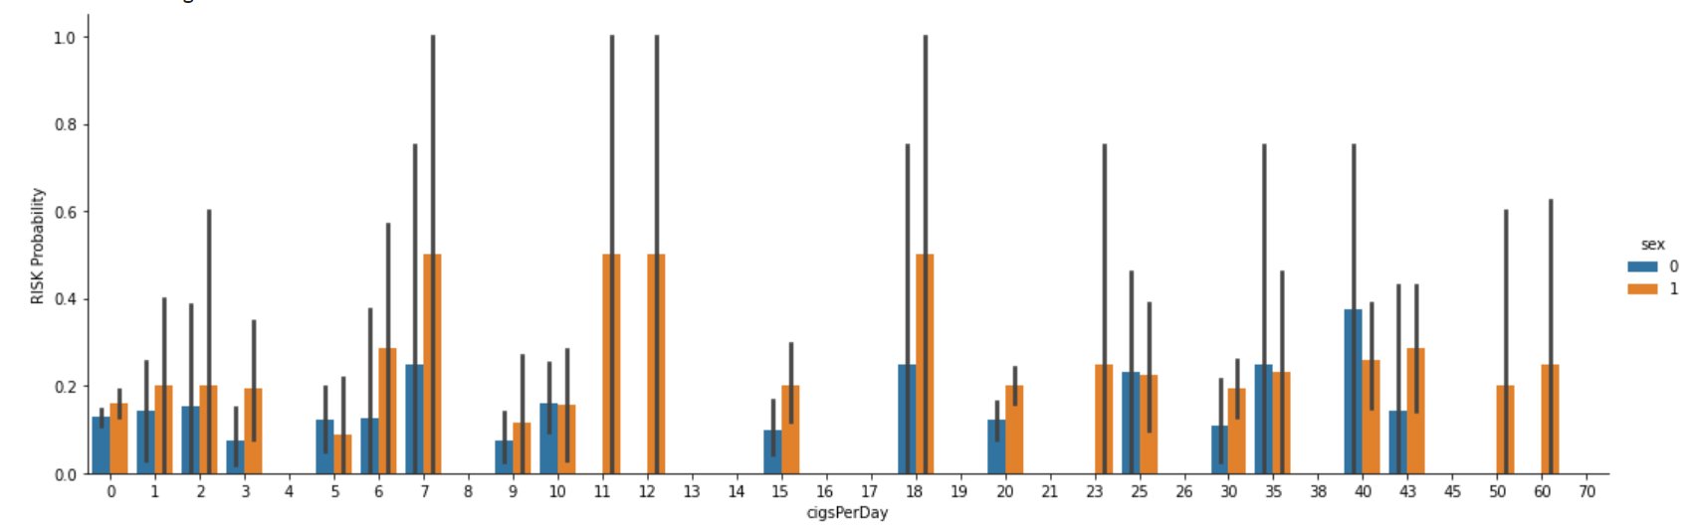
EDA on Features – CigsperDay, Sex & Risk
There is no Exact Inference to say that - less the cigarettes consumption means less heart disease and vice versa.
But Male, more than Female are in the high risk of Heart disease, since the proportion of male smokers v/s female are high and on a reality smokers will be having high risk of getting heart disease.

Slide 14
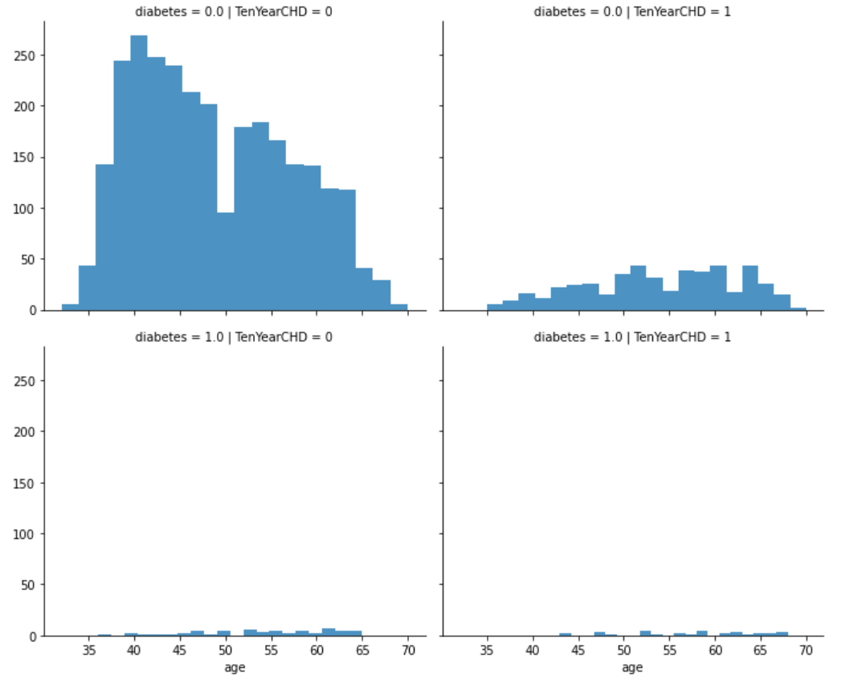
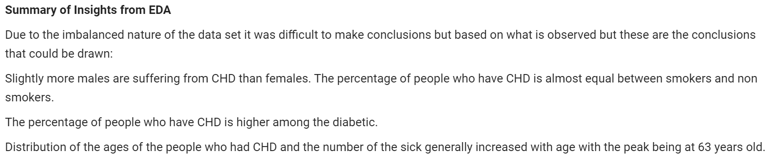
EDA on Features – Diabetes, Age, Risk
Non Diabetic – Less risk of heart disease.
Diabetic – High risk of heart disease

Slide 15
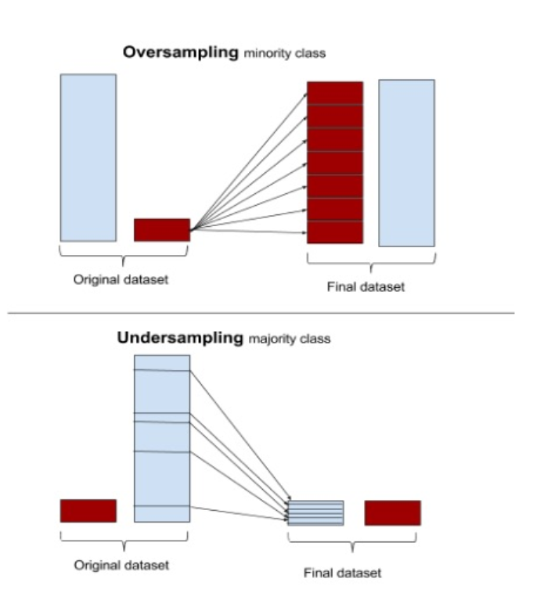
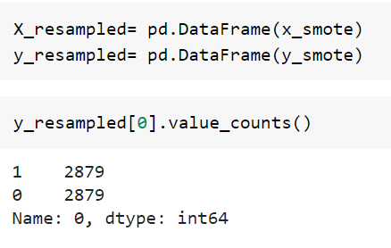
Handling Imbalance Data
Common Methods to Handle Imbalance Data
Under sampling the majority class
Over sampling the minority class
SMOTE
Synthetic Minority Over Sampling Technique
Reduces overfitting during oversampling
Synthetic Sampling is used

Slide 16
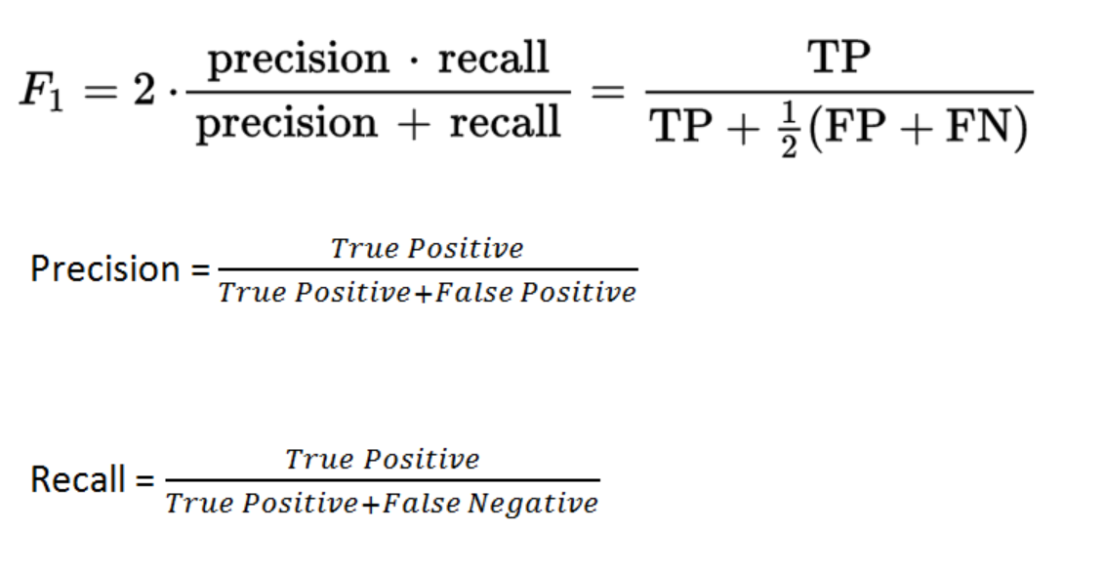
Evaluation Metric
Evaluation Metric
Recall
F1 Score
ROC Curve

Slide 17
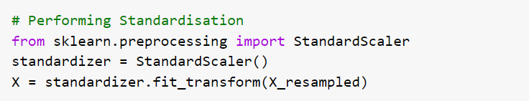
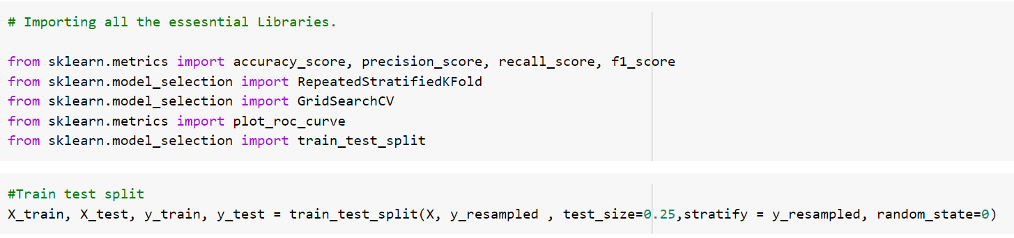
Data Splitting & Standardizing

Slide 18
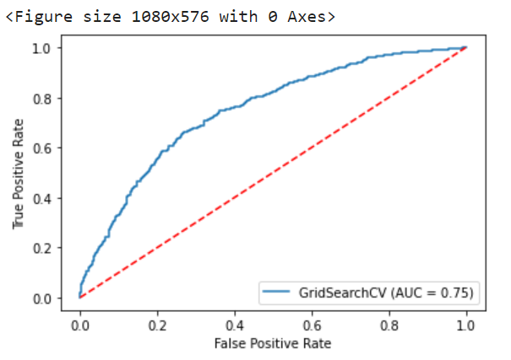
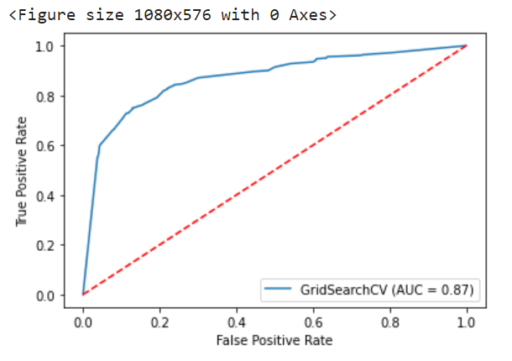
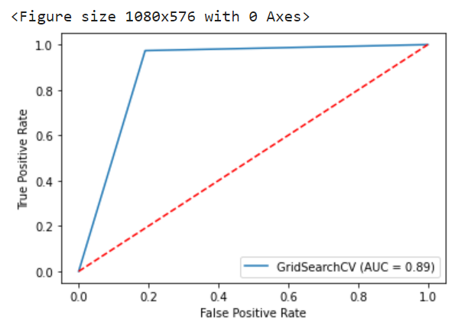
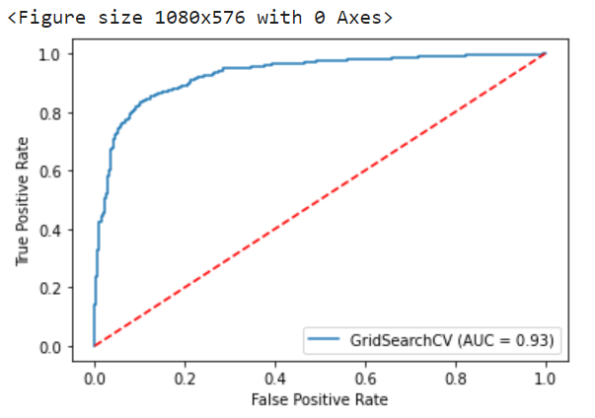
Model Training, Testing & Hyper-Parameter Tuning
Logistic Regression
K Nearest Neighbour
Decision Trees
Support Vector Machine

Slide 19
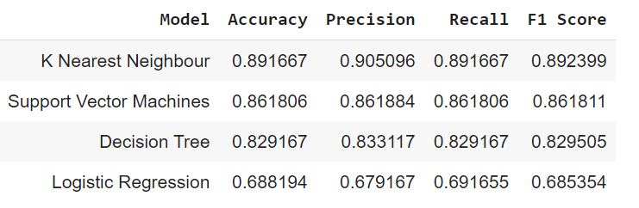
Performance Comparison
Conclusion
Among all the Classifiers used here, K Nearest Neighbour classifier has the best performance with highest RECALL and F1 SCORE of 89%.

Slide 20
Scope of Improvement
With the Interest of time we kept certain things for the future work which is as follows:
Since the data given to us has less records we used oversampling technique. But In a reality Health data will be imbalanced and will be huge so we can try work on cost sensitive learning which instead of altering the data records will just give more weightage to minority and focuses on the heart risky patients.
Feature Importance with respect to each classifiers.

